Slide 1
Computer Vision Homework 2
TA:
林伯豪: borhaur@gmail.com
劉心慈: kab49abc@gmail.com
吳慈娟: myps40231@gmail.com
林恩宇: s9872051@gmail.com
Office Hour: 15:00~17:00, Mon.
20:00~22:00, Tue.
At CSIE 9F Robotics Lab.

Slide 2
Notices (1/2):
Copying is strictly prohibited!! Penalty: instant zero for both side!!
If the code can’t run ,you have one week to come to our Lab and show that your program can work, otherwise you will get zero!!
Due date => 3 January 2018 (Wednesday) 23:59:59
- No delay. If you submit homework after deadline, you will get 0.
Upload to => 140.116.154.1 -> Upload/Homework/Hw2
- User ID: Cv2017 Password: Cv2017
Format
- Filename：Hw2_StudentID_Name_Version.rar
Ex: Hw2_F71234567_林小明_v1.rar
- Content: project folder*( including the pictures ) *note: remove your “Debug” folder to shrink file size

Slide 3
Notices (2/2):
Use OpenCV 2.4.7
Visual Studio 2013 (you can download from http://www.cc.ncku.edu.tw/download/ )

Slide 4
Grading:
0. Homework Format
1. (15%) Background Subtraction
2. (25%) Optical Flow tracking
2.1 Preprocessing (10%)
2.2 Tracking whole video (15%)
3. (30%) Principal Component Analysis
3.1 Eigenvectors and eigenvalues (15%)
3.2 Face Recognition (15%)
4. (30%) Face Detection & Recognition
4.1 Face Detection (15%)
4.2 Face Detection + Recognition (15%)

Slide 5
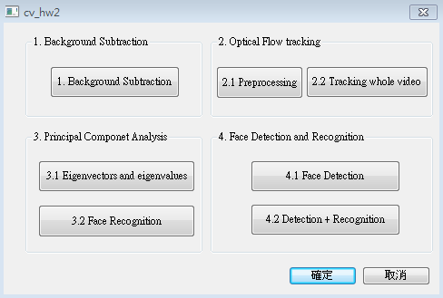
0. Homework Format
Use MFC to create GUI like following picture

Slide 6
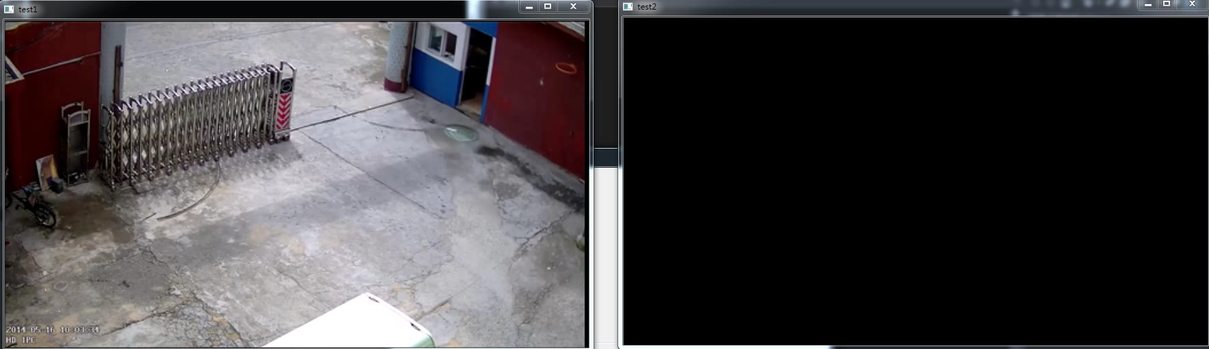
1. (15%) Background Subtraction
Read the video (bgSub_video.mp4) and extract the foreground.
1) (15%) Open two windows and display the original video and the foreground video respectively.
Hint : (ref. : opencv2refman_2.4.7.pdf) ref. P372 ~ P376
Demo video:

Slide 7
2. (25%) Optical Flow tracking
2.1 Preprocessing (10%)
2.2 Tracking whole video (15%)

Slide 8
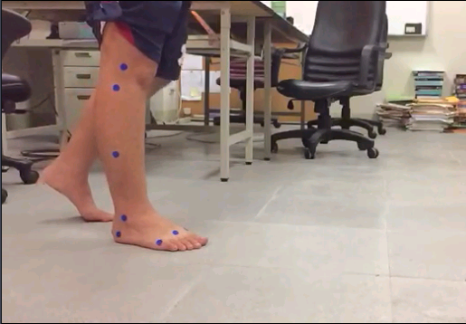
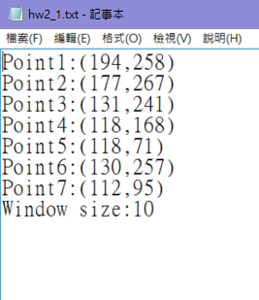
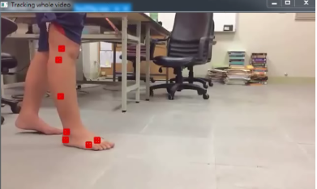

2.1 Preprocessing (10%)
Read the video (tracking_video.mp4), and then decide the seven tracking points' initial positions and window sizes.
(5%) Save the seven tracking points’ initial positions and window sizes (hw2_1.txt)
(5%) Show the result on the first frame.
Ex:
x
hw2_1.txt
(0,0)
window size
y

Slide 9
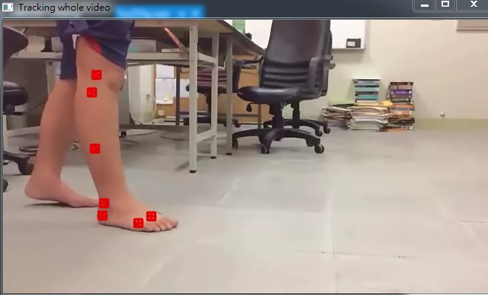
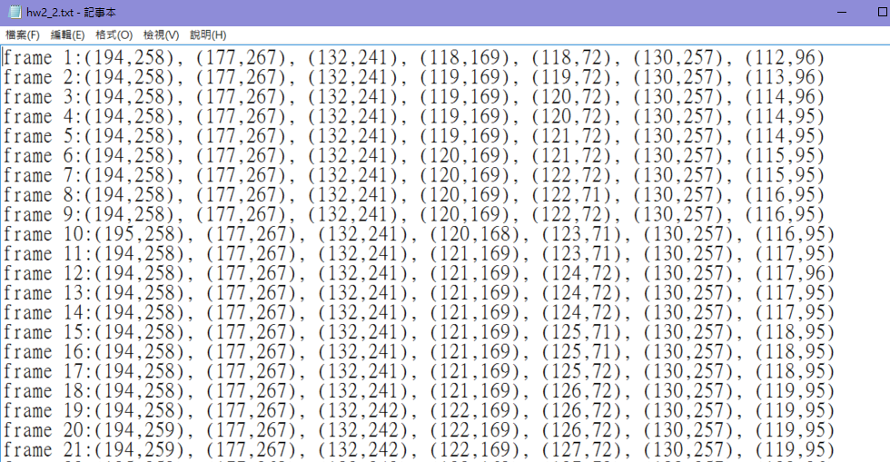
2.2 Tracking whole video (15%)
Tracking the seven points on the whole video previously and save the whole points on the text file (hw2_2.txt).
Next, read the text file and draw these points on the video, connecting these points to get a tracking line.
Hint: OpenCV Textbook Chapter 10 (P332 ~ P334)
hw2_2.txt
Demo video:
※Tracking process may be fail, you can adjust points' positions on some frames and then track again.

Slide 10
3. (30%) Principal Component Analysis
3.1 Eigenvectors and eigenvalues (15%)
3.2 Face Recognition (15%)

Slide 11

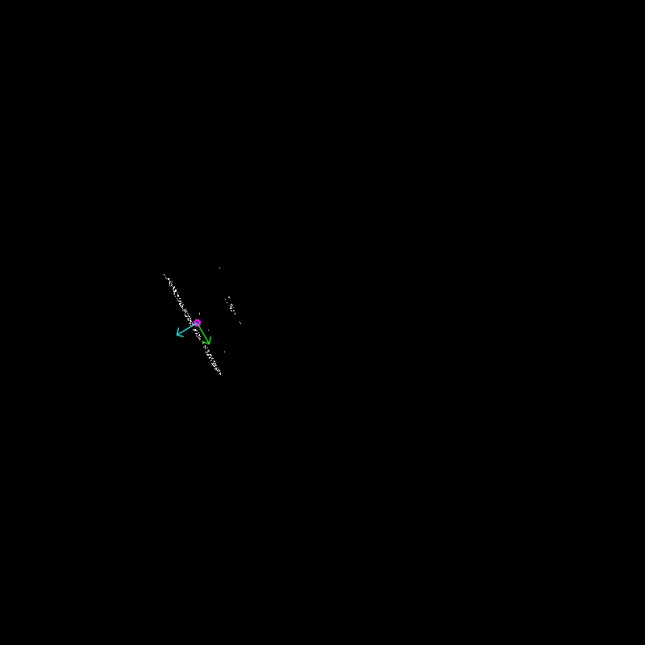
3.1 Eigenvectors and eigenvalues (15%)
Given the image (pca.jpg), take white pixels as 2D points in the image coordinate and then use pca to find principal components of these points.
1) (15%) Draw center point, two directions of eigenvector and their corresponding eigenvalues on the original image. (Pink circle: center point, Green: first axis, Blue: second axis)
Hint: (ref. : opencv2refman_2.4.7.pdf) ref. P156 ~ P159
Input: Output:
(0,0)
x
y

Slide 12
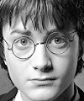
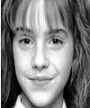
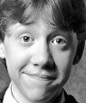
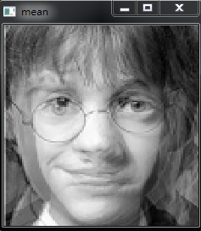
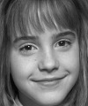
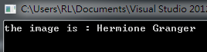
training data: (100*120)
0.jpg
1.jpg
2.jpg
3.2 Face Recognition (15%)
Harry Potter
Hermione Granger
Ron Weasley
Given three face images (0.jpg ~ 2.jpg), use eigenface to recognize the face.
1) (5%) Show the result of the mean face.
2) (10%) Given a test image (test.jpg), show the name of the person on the console window.
Hint: (ref. : opencv2refman_2.4.7.pdf) ref. P681 ~ P743
Output format:
test data:
(100*120)
Hermione Granger

Slide 13
4. (30%) Face Detection & Recognition
4.1 Face Detection (15%)
4.2 Face Detection + Recognition (15%)

Slide 14
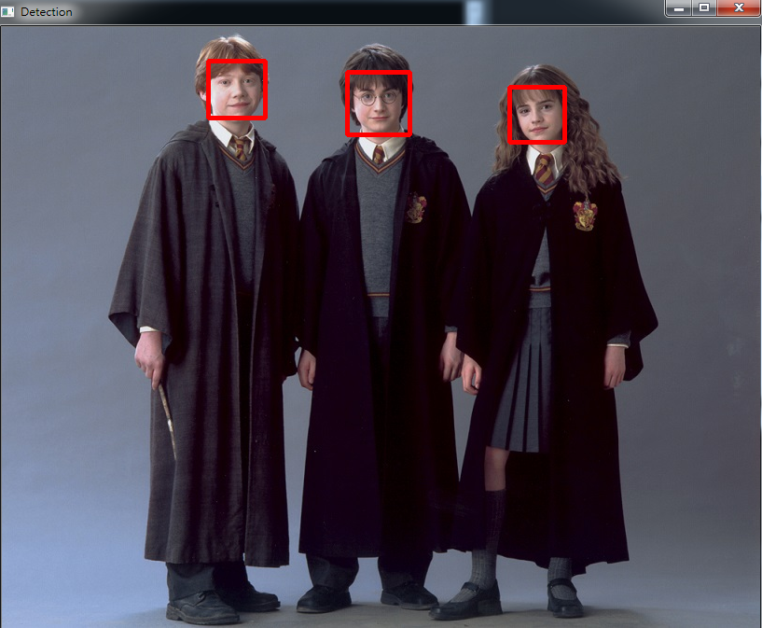
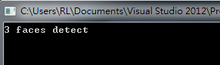
4.1 Face Detection (15%)
Given the image (face.jpg), detect the faces on the image by using Adaboost.
1) (5%) Output the number of faces detected on the console window.
2) (10%) Draw a rectangle on each face, and show the result.
Hint: (ref. : opencv2refman_2.4.7.pdf) ref. P447 ~ P453
Output format:

Slide 15
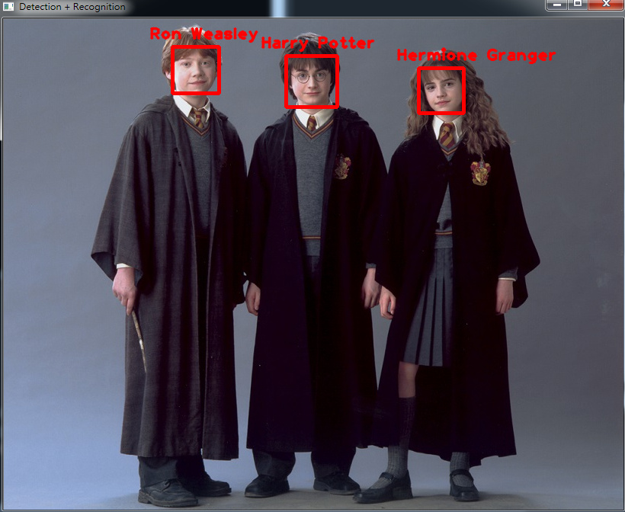
4.2 Face Detection + Recognition (15%)
Use the result of detected faces in 4.1, and use 3.2 to recognize them.
1) (15%) Show the name of each person.
Output format:

